Slide 1
NU FLEX HIGH SPEED SHAFT COUPLINGS
NUTECH
INDUSTRIAL PARTS
PRIVATE LIMITED

Slide 2
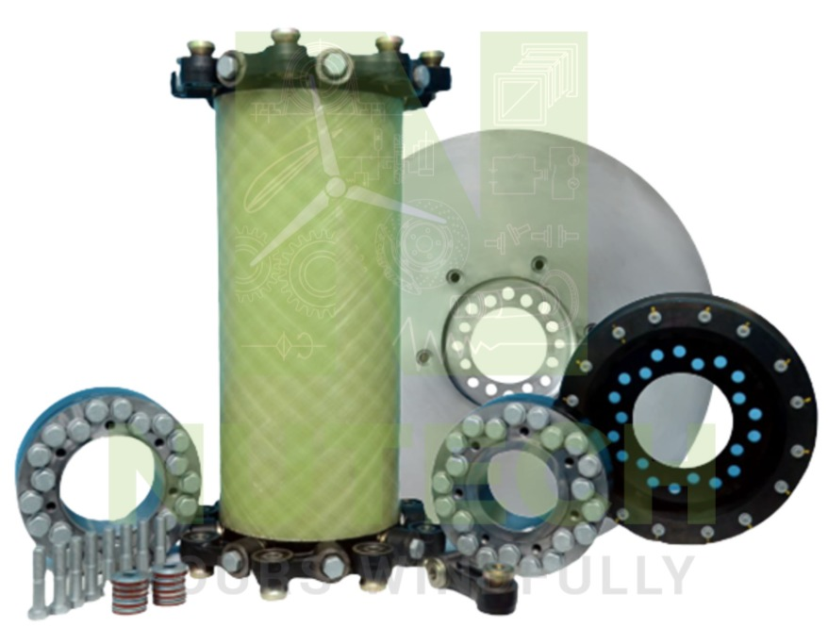
WIND TURBINE COUPLING
NUTECH Manufactures and Supplies 0.5MW - 2MW.
Recently developed – 3MW. Customer validation commences shortly.
Having design & manufacturing capacity up to 5MW with our current facilities.

Slide 3
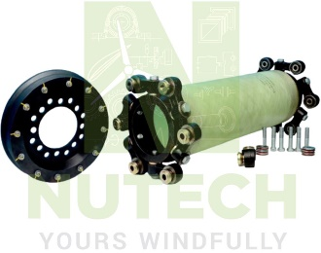
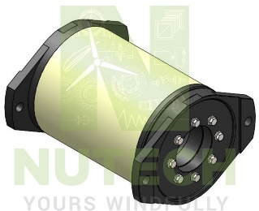
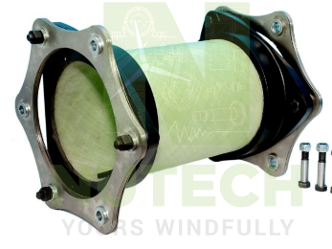
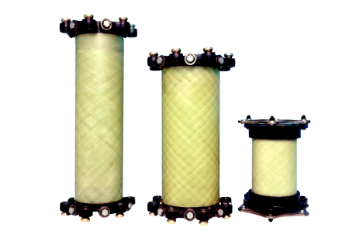
NU FLEX COUPLINGS - VARIANTS
Using the GFRP tube bonded both ends with metal flange, NUTECH has developed many models of coupling
GFRP tube with shim (inbuilt torque limiter)
GFRP tube and rubber link arms
(12 Arms)
GFRP tube and rubber link arms
(14 Arms)
GFRP tube with shim
GFRP tube and rubber link arms
(16 Arms)
It ranges from 0.5 MW to 3 MW

Slide 4
NU FLEX COUPLINGS - SPECIFICATIONS
 | 0.5 – 0.66 MW Rated torque : 6000 Nm Maximum torque : 12000 Nm Slip torque (torque limiter) : None Max. axial misalignment : ±12 mm Max. angle misalignment : 2° | Max. radial misalignment : 15 mm Spacer tube made of GFRP Disc pack made of 1 mm thick of stainless steel (shims)
 | 0.75 – 0.85 MW Rated torque : 8400 Nm Maximum torque : 10000 Nm Slip torque (torque limiter) : Yes Max. axial misalignment : ±12 mm Max. angle misalignment : 2° | Max. radial misalignment : 15 mm Space made of GFRP Disc pack made of 3 mm thick STEEL 690QL

Slide 5
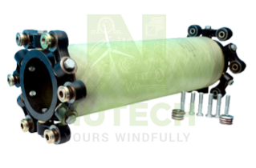
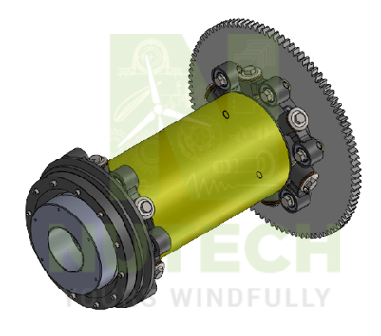
NU FLEX COUPLINGS – SPECIFICATIONS (CONT…)
 | 2.0 MW Rated torque : 16900 Nm Maximum torque : 30000 Nm Slip torque (torque limiter) : Yes Max. axial misalignment : ±12 mm Max. angle misalignment : 2° | Max. radial misalignment : 15 mm Spacer tube made of GFRP Rubber flexible Link arms (16 Nos) used for load carrying
 | 3.0 MW Rated torque : 26000 Nm Maximum torque : 49000 Nm Slip torque (torque limiter) : Yes Max. axial misalignment : ±12 mm Max. angle misalignment : 2° | Max. radial misalignment : 15 mm Space made of GFRP Rubber flexible Link arms used for load carrying

Slide 6
NU FLEX COUPLINGS – TECHNICAL INFORMATION
TYPE | CAPACITY | TORQUE |  |  | SPEED |  | MIS-ALIGNMENT
 |  | RATED (Nm) | MAX. (Nm) | SLIP (Nm) | RATED (RPM) | MAX (RPM) | AXIAL (mm) | Angle (deg) | Radial (mm)
NTC-SHIM | 0.5 – 0.66 MW | 6000 | 12000 | NA | 750 - 1500 | 1800 | ±12 | 2 | 15.9
 | 0.75 – 0.85 MW | 8400 | 10000 | 7200 - 9700 | 750 - 1500 | 2000 | ±12 | 2 | 15.9
NTC-LINK ARM | 2.0 MW | 16900 | 30000 | 21000 - 30000 | 450 – 1320 | 1620 | ±4 | 0.5° | ≤ 6
 | 3.0 MW | 25650 | 31500 | 36000 – 48700 | 650 – 1200 | 1800 | ±6 | 0.7° | ≤ 9

Slide 7
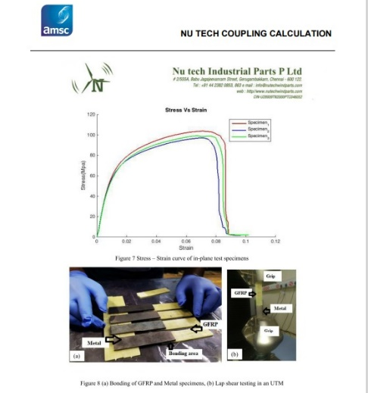
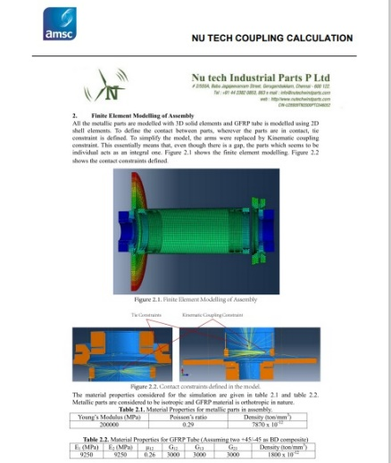
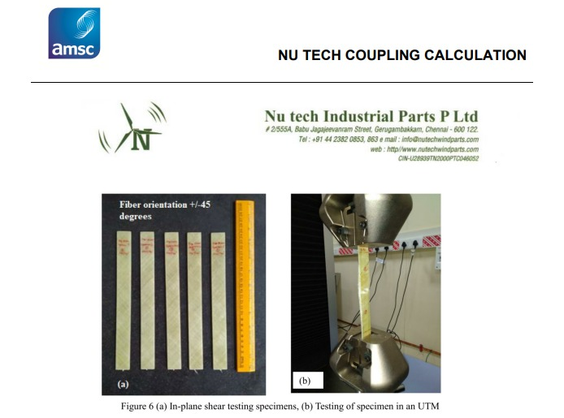
NU FLEX COUPLINGS – DESIGN DATA
INPUT DOCUMENTS GIVEN FOR AMSC DESIGN APPROVAL

Slide 8
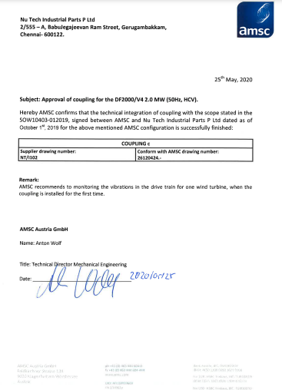
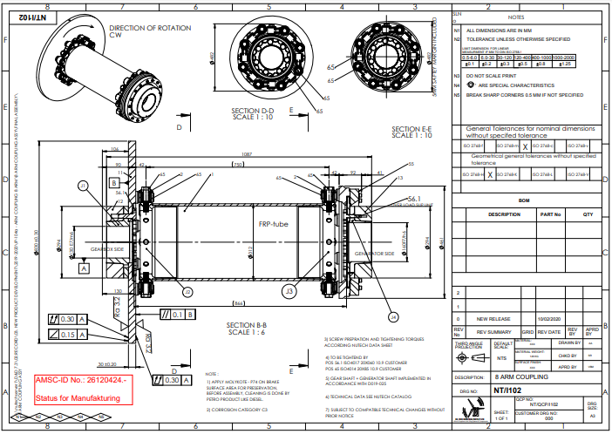
NU FLEX COUPLINGS – AMSC DESIGN APPROVAL
AMSC APPROVAL CERTIFICATE & DRAWING APPROVAL IN NUTECH DESIGN (DRAWING)

Slide 9
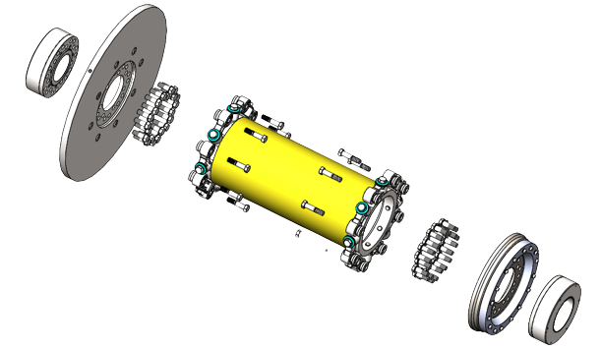
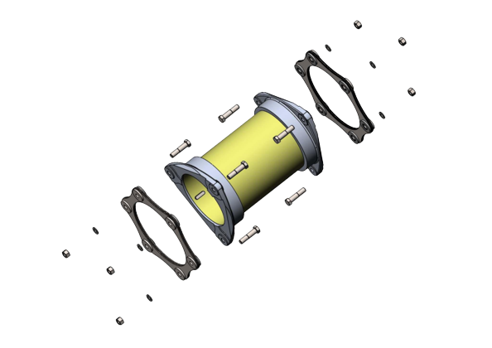
NU FLEX COUPLINGS – KEY FEATURES
NTC - LINK ARM
(2MW – 3MW)
NTC-SHIM
(0.5 - 0.85 MW)
Torque Limiters
When overload to be more than specified torque happened, Slipping unit embedded in torque limiter cuts the power to protect power train components and it operates without remarkable decrease of torque during required life period. It is applied to 0.75MW and above. Torque Limiter comes with inbuilt as well as separate. After slipping count, it is refurbishable.
Keyless Shaft coupling
It is easy to install because keyless type is applied in order to connect the shaft of generator and gearbox. Clamping and declamping can be done by selection of graded bolts, with out much effort and hydraulic equipments or special tools.
Spacer Tube
When leakage current occurred, Glass fiber reinforced plastic with superiority of electrical isolation and strength is applied in order to prevent the damage of power train components. It is designed to be able to endure temperature range of -30 °C to +70 °C.
Miscellaneous
Exterior coupling parts are designed to meet ISO 12944 grade C3 for onshore and C4 offshore. Suitable damping capacity of material is provided effectively to prevent the vibration of axial direction.

Slide 10
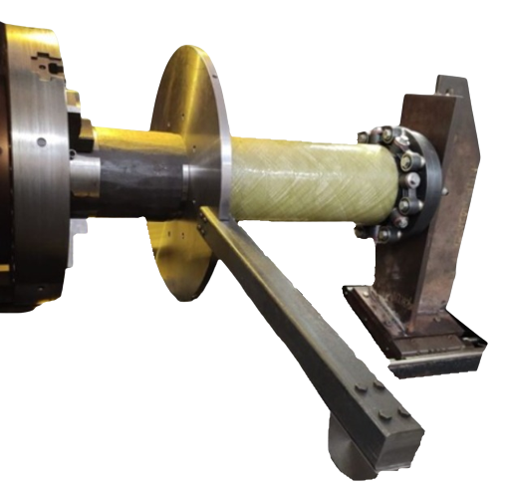
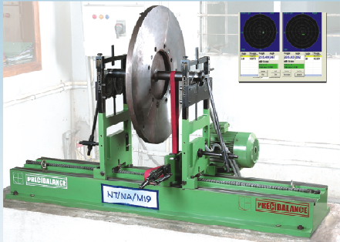
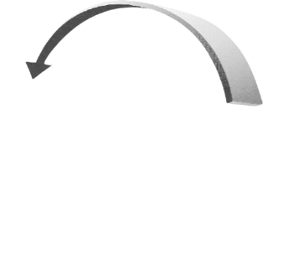
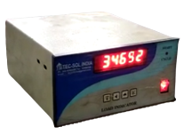
NU FLEX COUPLINGS – QUALITY ASSURANCE
INHOUSE TESTING FACILITIES
BALANCING MACHINE
DESIGN VALIDATION
1. Critical Speed
2. FE Analysis
3. Fatigue Life
4. Torque Analysis
DOCUMENTS WE PROVIDE
1. Slip Torque Report
2. Balancing Report
3. Installation Manual
4. Technical Datasheet
TORSION TESTING

Slide 11
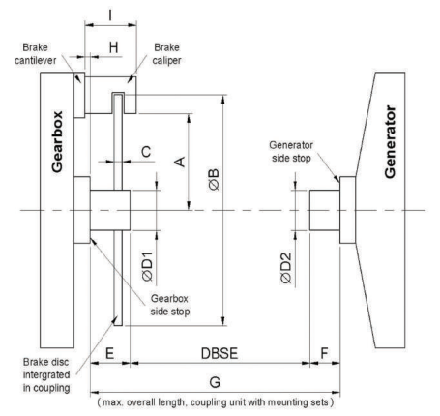
NU FLEX COUPLINGS – DATA REQUIRED FOR NEW DEVELOPMENT
Name of the wind turbine
Dimensions
A mm (with tolerance)
B mm
C mm (with tolerance)
D1 mm (with tolerance)
D2 mm (with tolerance)
DBSE mm
E mm
F mm
G mm
H mm
I mm (with tolerance)
Technical data
Electrical power
Operating speed
Maximum speed
Electric resistance
Rated torque
Max. torque in operation
Min. slip torque
Max. slip torque
Max. braking torque
Brake disc material
Max. axial misalignment
Max. angle misalignment
Max. radial misalignment

Slide 12
Thank you
Contact - NUTECH INDUSTRIAL PARTS PVT LTD
Cell - 98401 68832
Email - sales@nutechwindparts.com
Web - www.nutechwindparts.com
Follow us on -

